Slide 1

Dual Enrollment
Poinciana High School

Slide 2

What is Dual Enrollment?
Dual Enrollment is a program that allows students to pursue an advanced curriculum that can earn the student both high school credit and college credit simultaneously

Slide 3




Dual Enrollment (DE)
Variety of DE offerings including Valencia College, UCF, UF, Osceola Technical College
Ability to earn high school and free college credit simultaneously
The start of your college GPA
Full-time and part-time options
Classes offered online, mixed mode and face-to-face
  District provides transportation to the Valencia
  Poinciana Campus
Opportunity to earn A.A. Degree and high school diploma simultaneously (60 college credits)

Slide 4
Valencia DE Admissions Requirements
9-12th grade
  Students under the age of 16 need a parent/guardian to accompany the student to any on-campus courses
Minimum 3.0 GPA
Test score requirements (PERT, SAT or ACT)
Level 3 or higher on FSA/FAST ELA PM3 Reading (preferred)

Slide 5
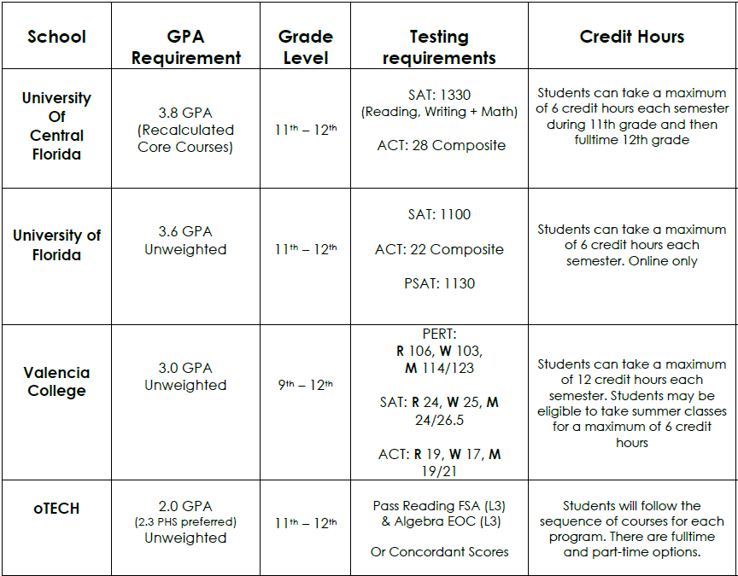

Slide 6

Benefits DE
Get a head start on earning college credit
Gain access to college resources and campus life
Explore interesting subjects through a variety of course offerings
Engage with different instructional methods available: Classroom, Online, or Mixed-mode
Experience the college atmosphere
Offset the cost of a college education
Stand out among your peers

Slide 7
Contact information
Ms. Shanel Morris- Last Names A-L
Mrs. Roberta Medina DaSilva- Last Names M-Z
PHS Dual Enrollment Counselors
Shanel.Morris@osceolaschools.net
Roberta.Medina@osceolaschools.net

